Slide 1
Summary of FMWT Station Locations
March 3, 2021

Slide 2
Background
Following slides to illustrate FMWT station locations and changes over time
Currently FMWT samples 122 stations each month, of those 100 are long-term locations used to determine index calculations
32 stations are used for zooplankton samples
45 stations are used for USFWS recovery index of Delta Smelt and Longfin Smelt

Slide 3
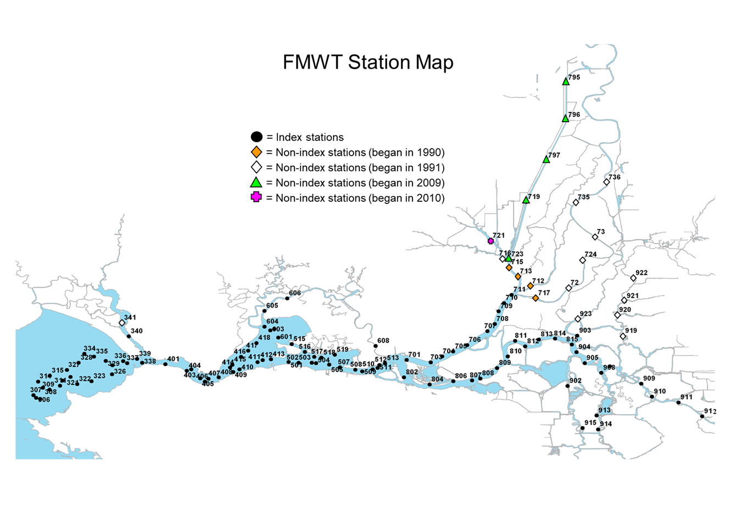
FMWT stations 2021

Slide 4
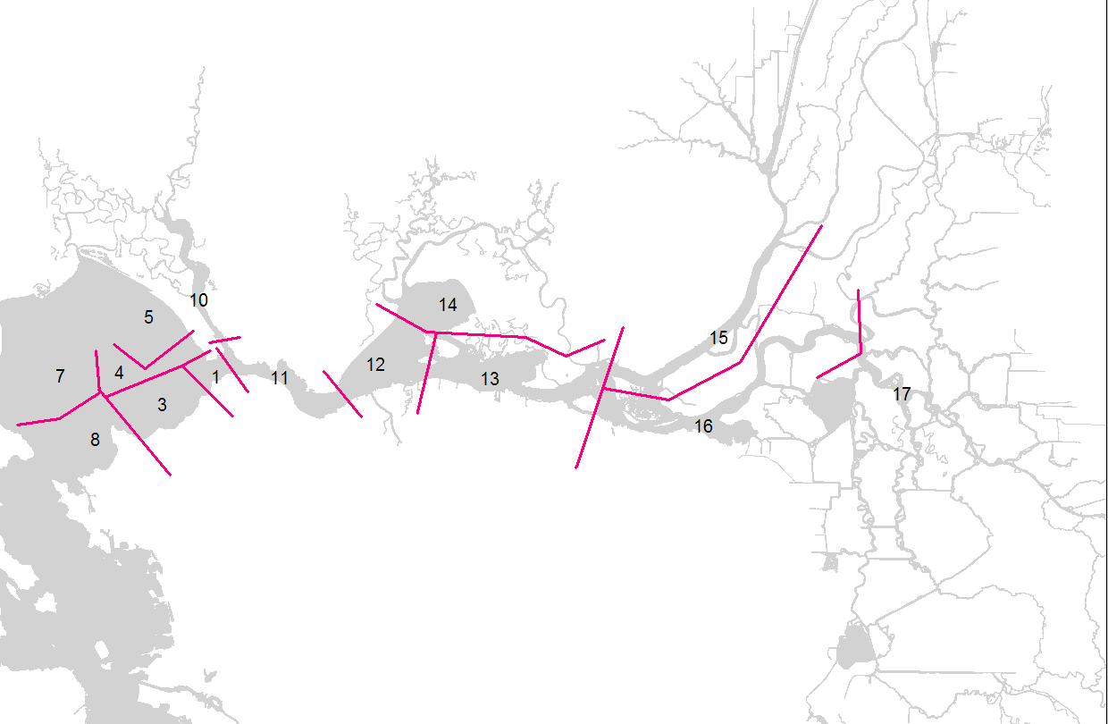
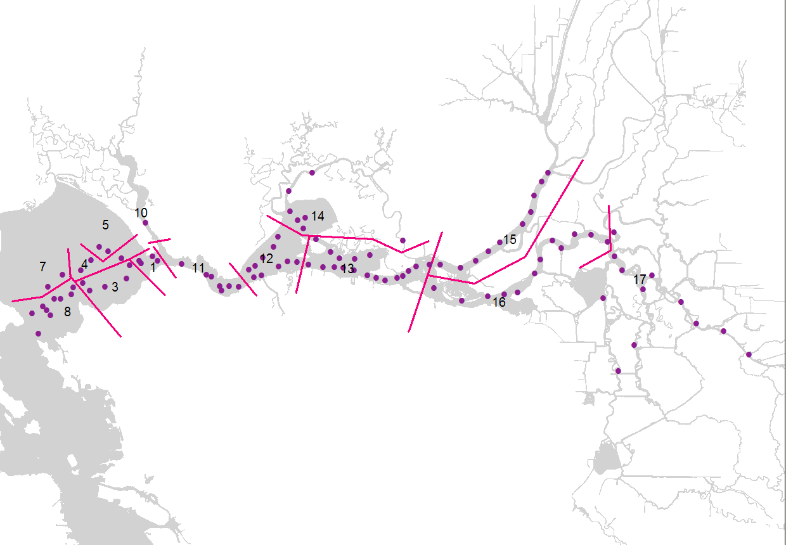
Map of areas used to generate annual index (“index stations”)

Slide 5
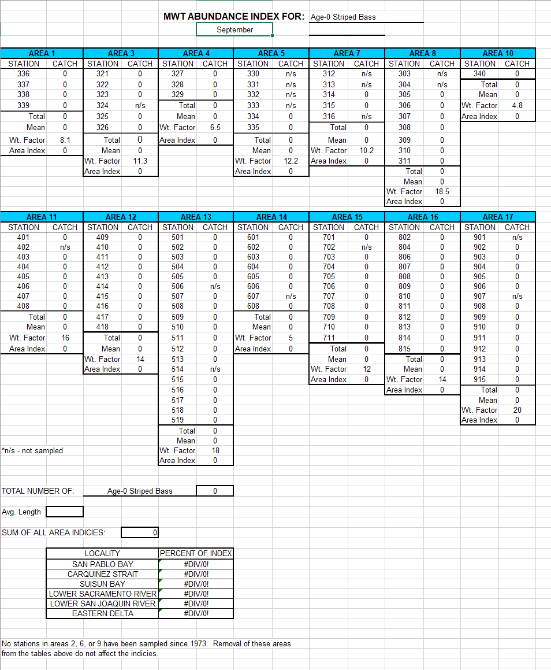
Areas include groups of stations that are used to generate monthly index
Stations were distributed among water bodies see FMWT protocol Appendix 11 for “Area Volumes and Weight Factors”

Slide 6
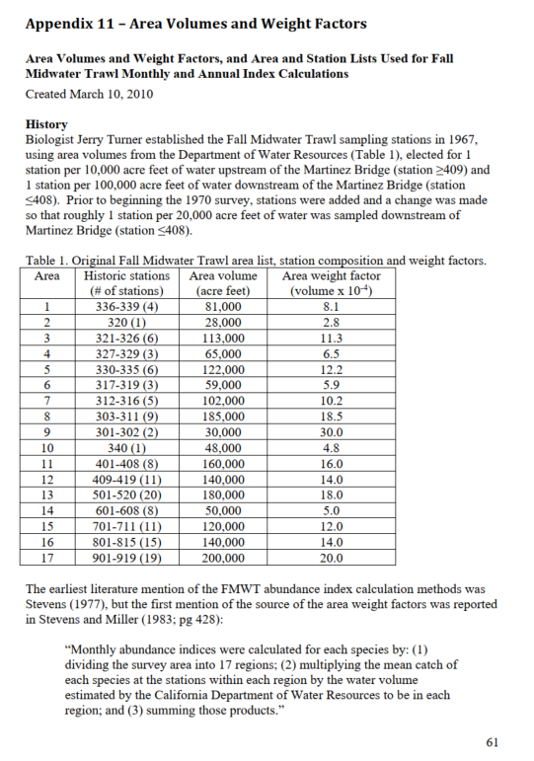
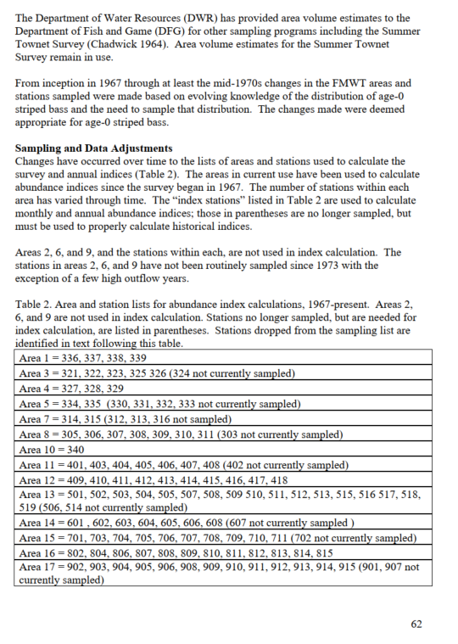
FMWT Protocol Appendix 11

Slide 7
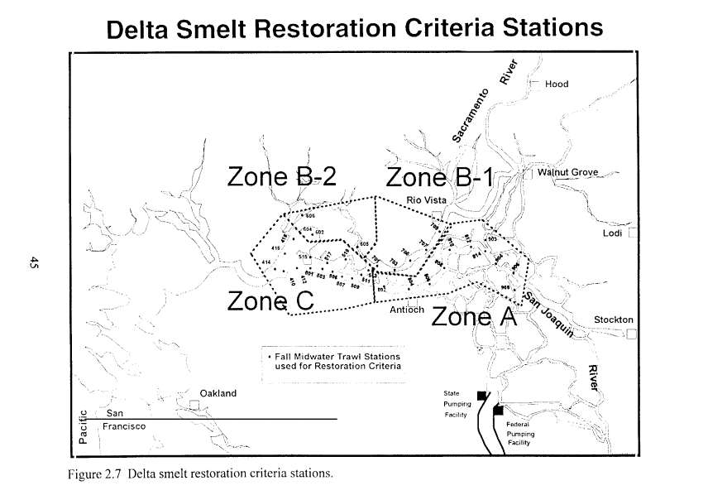
Other indices – 1995 USFWS Recovery Index
Map of Fall Midwater Trawl Delta Smelt restoration criteria stations from the Sacramento-San Joaquin Delta Native Fishes Recovery Plan (U.S. Fish and Wildlife Service 1995).

Slide 8
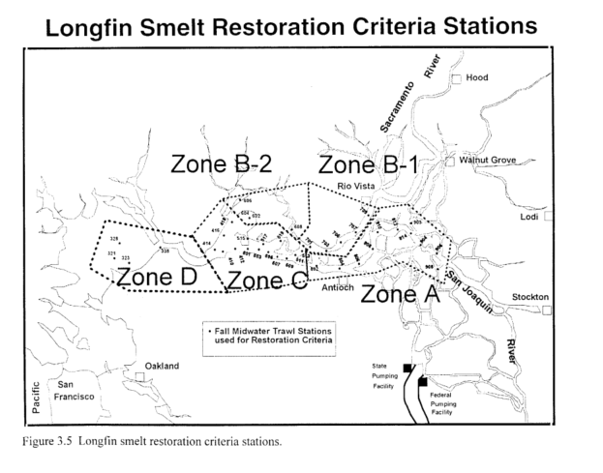
Other indices – 1995 USFWS Recovery Index
Map of Fall Midwater Trawl Longfin Smelt restoration criteria stations from the Sacramento-San Joaquin Delta Native Fishes Recovery Plan (U.S. Fish and Wildlife Service 1995).

Slide 9
Other information needs
Compliance
ITP

Slide 10
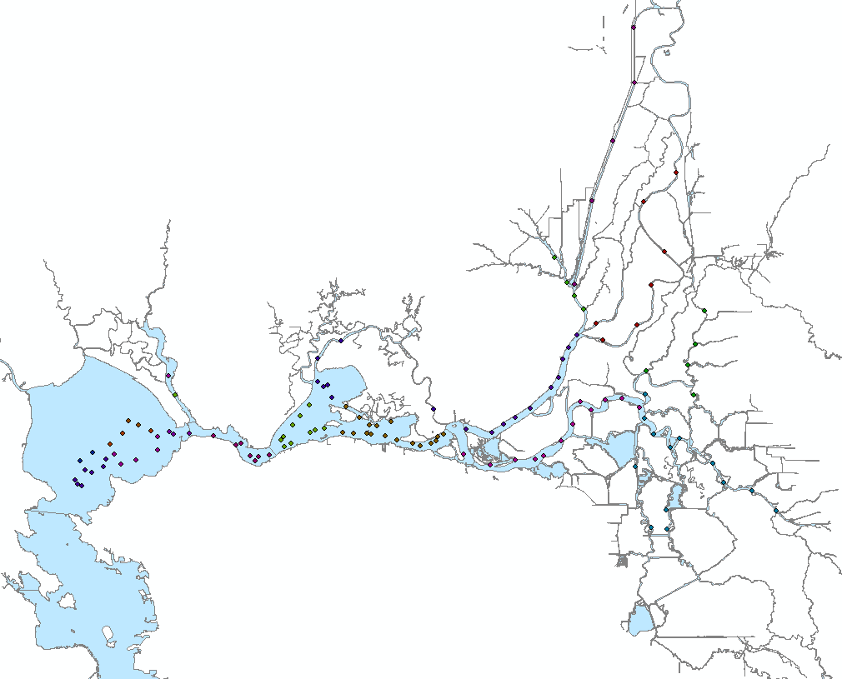
FMWT stations 2021 – per area

Slide 11
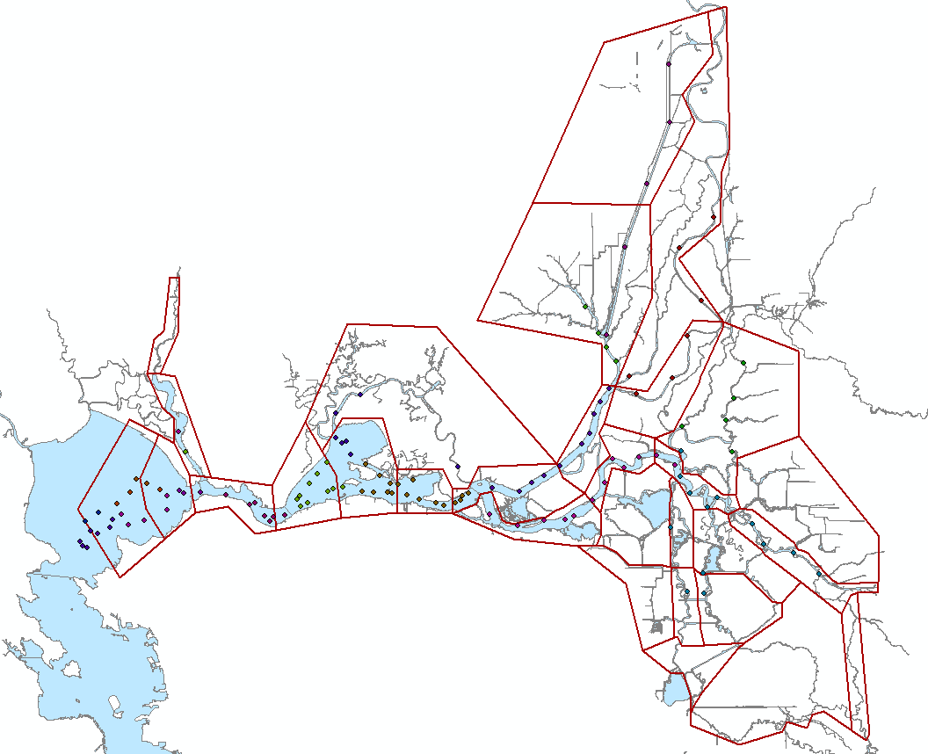
FMWT stations 2021 – with DSLCM subregions

Slide 12
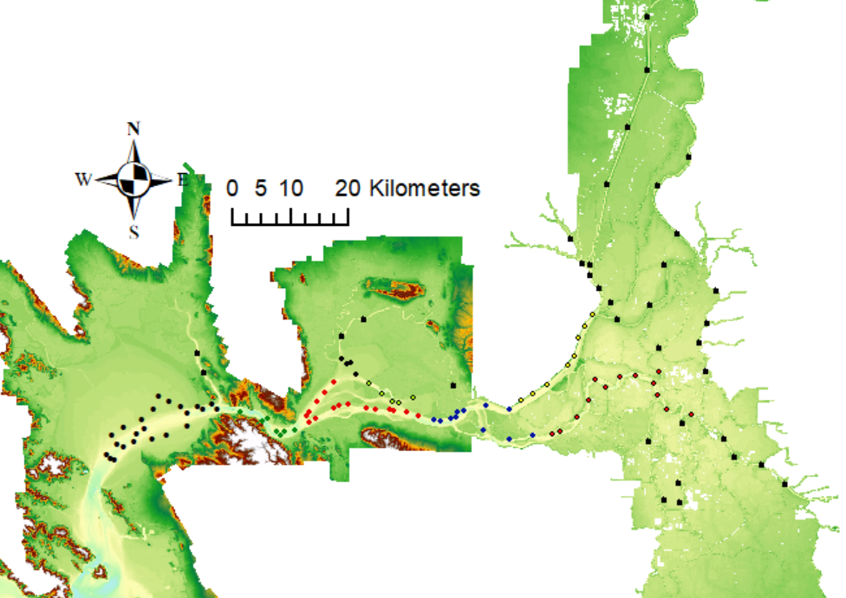
FMWT stations 2021 – with bathymetry

Slide 13
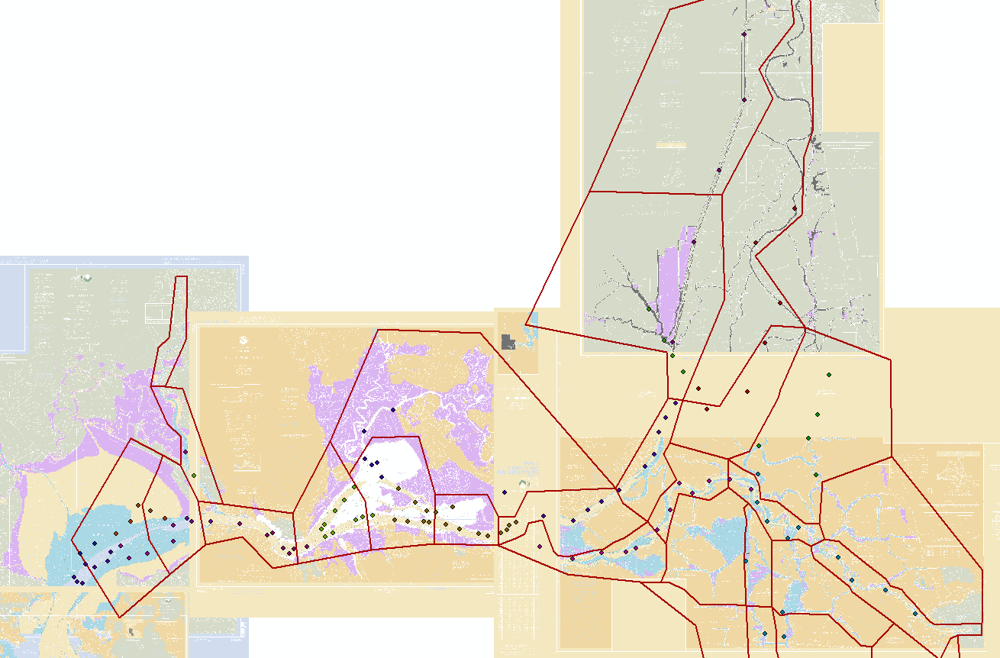
FMWT stations 2021 – with nautical chart depths

Slide 14
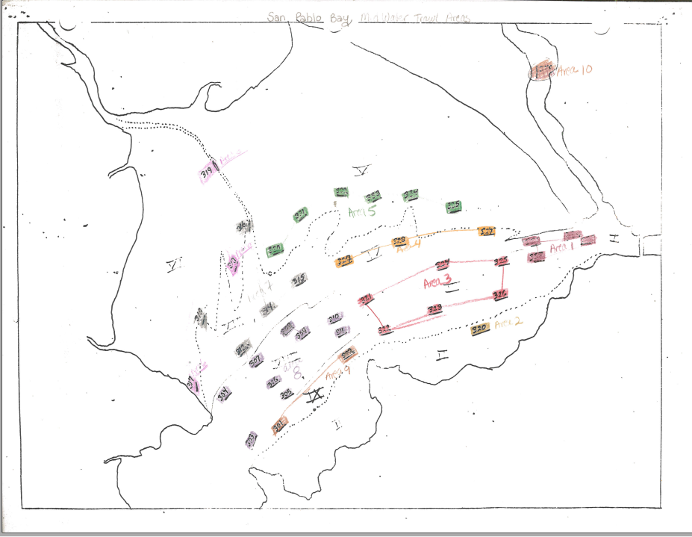
Historical FMWT station locations by area in San Pablo Bay, design with nautical charts

Slide 15
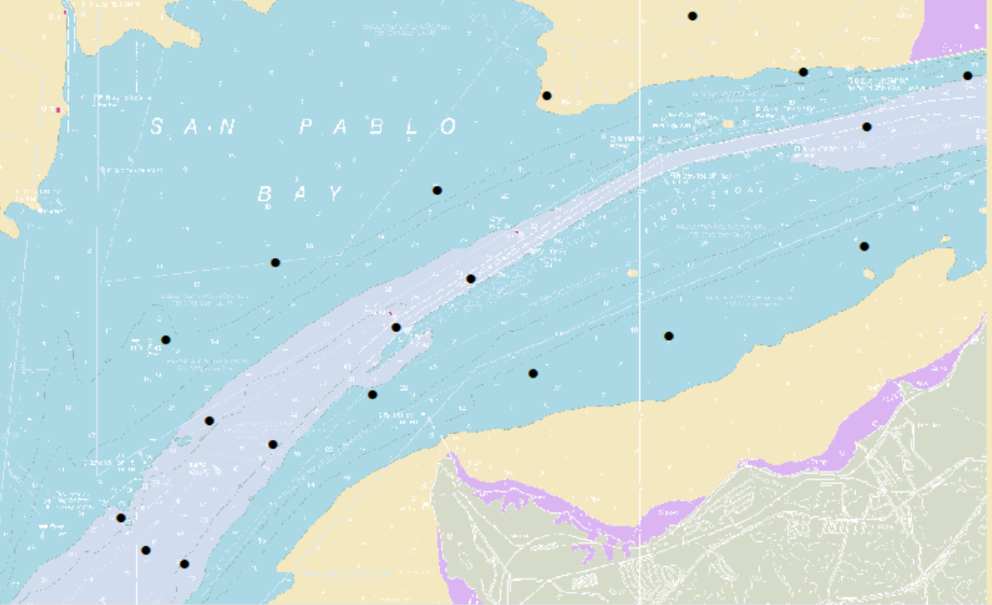
FMWT stations 2021 – San Pablo Bay Nautical Chart
Note stations in channel, outside channel, channel shoal interface, and on shoal

Slide 16

FMWT stations 2021

Slide 17
Considerations
Stations sample pelagic channel habitat as it the primary habitat influenced by water project operations (outflow – exports)
Major habitat type by volume in estuary
Flow/exports are controlled by resource managers
Tidal flux
Stations distributed in space to account for distribution and abundance of small fish
To show location and distribution of fish relative to south Delta export facilities
Stations as a unit of larger area and habitat
Claimed index as assumptions to generate population estimates could not be met at design of study
Tidal flux with pelagic fish movement leads to conclusions of fixed stations being similar to random sampling for most of the upper estuary tidally influenced.
Physical features of bathymetry

